Slide 1
Secure Youth Treatment Facility - Overview

Slide 2
Valley Oak Youth Academy Program
The Valley Oak Youth Academy (VOYA) provides a safe and secure environment for youth serving commitments within the Sacramento County Youth Detention Facility.
The program utilizes comprehensive assessments, therapeutic interventions, and a multidisciplinary approach to:
Support positive outcomes for youth and public safety;
Reduce transfers of youth to the adult criminal justice system;
Reduce racial and ethnic disparities; and
Reduce confinement in the juvenile justice system.
Notes:
Complex work to meet the complex needs of youth at the furthest end of the jj continuum
SB 92 companion legislation supported a workgroup within Judicial Council to develop a sentencing matrix to address goals.

Slide 3
VOYA Program Services
Education and Career Technical Training
Mental Health Crisis Intervention
Medical Health
Therapeutic Services
Life Skills/Job Training
Pro-Social Enrichment Activities
Re-entry
Notes:
The Sacramento County Office of Education (SCOE) offers VOYA residents three educational pathways based upon their age and graduation status:
High School Diploma Program or HiSET Program
College: Associate Degree/Transferable Credits
Career Technical Education
Northern California Construction
Culinary
Mental Health Services:
Sacramento County Behavioral Health Services (BHS) currently has six clinicians who serve every youth at the Youth Detention Facility and facilitates a weekly Special Needs meeting to identify youth requiring a multi-disciplinary need for treatment.
Some of the services include:
• Assessment
• Crisis intervention
• Suicide Prevention
• Medication Support Services
Medical Health Services:
The Juvenile Correctional Health Program offers:
• Health Screenings and Education
• Immunizations
• Routine Medical, Emergency, and Infirmary Care
• Specialty Care and Case Management
• Dental Care
• Vision Exams and on-site Optometry
• Referrals to Mental Health Services
Staff includes Physicians, Dentists, Registered Nurses, Pharmacists, and a Program Manager
VOYA Treatment Partner:
Stanford Sierra Youth & Families (SSYAF) provides individualized services, including:
• A collaborative assessment
• Collaboration and partnership with officers assigned to the VOYA Unit
• Individual and group treatment (using evidence based and promising practices)
• Pro-social activities
• Peer mentoring
• Aftercare/re-entry community supportive service

Slide 4
Program Components
Individualized Rehabilitation Plan (IRP)
6 Month VOYA Progress Review Hearings
opportunities for baseline reduction
Victim Empathy Course
Stanford Sierra Youth and Family
ProjectME: Life Skills and Job Training Program
VOYA Employment Program
“Who’s This, What’s That?”: A Multi-Cultural Journey
Juvenile Sex Behavior Treatment Model
Step-Down Opportunities

Slide 5
Community Based Organizations (CBO’s)
CBO’s are integral in the VOYA service continuum. Supports and services include:
Skills building and pro-social enrichment activities for youth;
Natural support during the Multidisciplinary Team Meeting and reentry planning;
Reentry linkage, services, and support in collaboration with Probation’s Reentry Team;
Currently: 14 contract providers; 13 volunteers

Slide 6
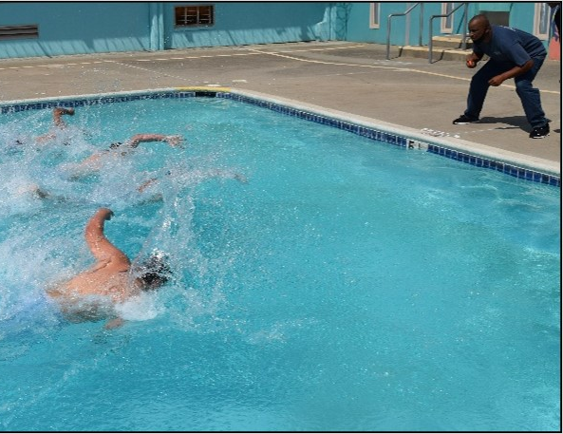
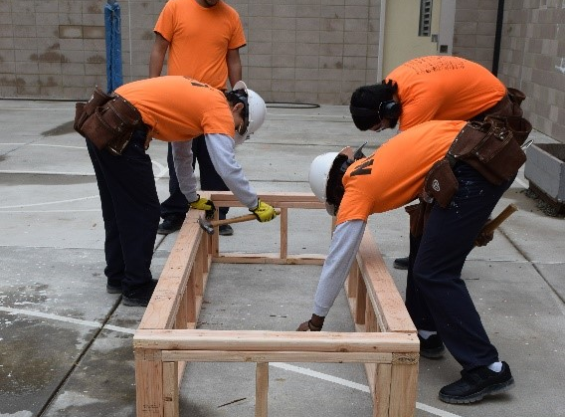
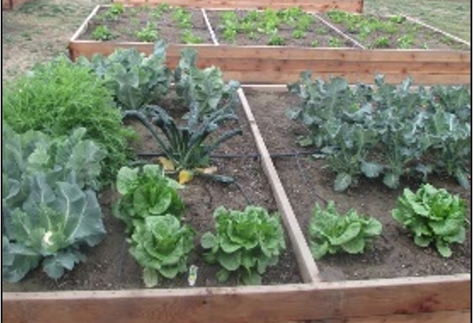
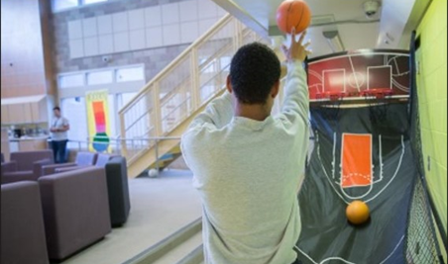
Other Programs Offered

Slide 7
VOYA Re-entry Program
Individualized case planning;
Re-entry planning with the youth, family, and multidisciplinary team (MDT*);
*MDT – VOYA Probation Officer, Reentry Probation Officer, Advocate, Education, Behavioral Health Services (BHS), Community-Based Organizations (CBO), and Attorney
Comprehensive assessment based on strengths and needs
Notes:
Youth and family voice and choice
Early and ongoing collaborative planning
VOYA Re-Entry is facilitated by specialized Juvenile Field officers who work with youth returning to the community, providing intentional coordination for community transition and stabilization through a teaming process that includes:
• a comprehensive assessment based on strengths and needs,
• development of individualized case and transition plan,
• Community-based service support and connection, and
• Family engagement

Slide 8
VOYA Program Update
DJJ stopped accepting new commitments effective July 1, 2021. Since then,
42 youth committed to VOYA, overall
35 currently in-custody
7 youth released
5 youth at Pine Grove Fire Academy (Step-Down)
2 youth within the community for Step-Down
36 youth returning from DJJ
4 youth ineligible for a commitment to VOYA
6 youth at State Prison
Notes:
DJJ Returnees: All but 2 youth have returned to the care and custody of Sacramento County through the 731.1 WIC process of recalling the commitment to DJJ and redisposition of cases. Several cases have resolved with various outcomes (commitments to VOYA; released to the community under probation’s supervision under on the reentry caseload) while several are still pending resolution of their case.

Slide 9
VOYA Program Update (cont’d.)
Since the implementation of the program, the Board has approved the use of SB 823 funding to support:
Four Housing Units for Supervision
Education Services
Mental Health and Therapeutic Services
Community-Based Services contracts
Community Advocate and Service Coordinator Services
Personnel for Public Defender’s Office
Re-entry Services
Community Outreach Unit (Stepdown Program)

Slide 10
VOYA Program Contract Interest
For individuals and organizations interested in providing services to Probation youth:
DJJ Realignment - Secure Youth Treatment Facility:
saccoprobation.saccounty.gov
Interested parties may also contact the Probation Fiscal Unit at ProbationContractInv@saccounty.gov ; please include "DJJ Realignment" in the subject line of the email.

